Slide 1
Puente Overview
April 2018

Slide 2
Mission: connect international development organizations with local institutions and underserved communities more efficiently to make development work more collaborative, impactful and sustainable
Vision: A world where development organizations collaborate smartly and selflessly to maximize their collective impact on the individuals and communities being served

Slide 3
1 | Executive Summary

Slide 4











Disconnect Drives Inefficiency in Development
A lack of coordination, communication, and confiánza prevents international development projects from reaching their goals
Development Organizations
Underserved Communities
Archaic data collection processes + lack of reliable health / socioeconomic data
Lack access to medical records, health clinics, health insurance
Lack of Trust & Alignment Between Key Stakeholders
+
Lack of Useful Data + Collaboration Across Project Cycles
=
Inefficient Use of Development Resources
Lengthy needs assessment + project planning phases due to lack of data / familiarity
Little faith or trust in in development groups to generate sustainable change
No connection with communities being served = skeptical, reluctant residents
Infrastructure-related health issues lie below the surface while quick fixes take priority
Short duration projects with limited scope and little-to-no ongoing maintenance/support
Lack relationships to connect neighborhood projects with outside development resources

Slide 5
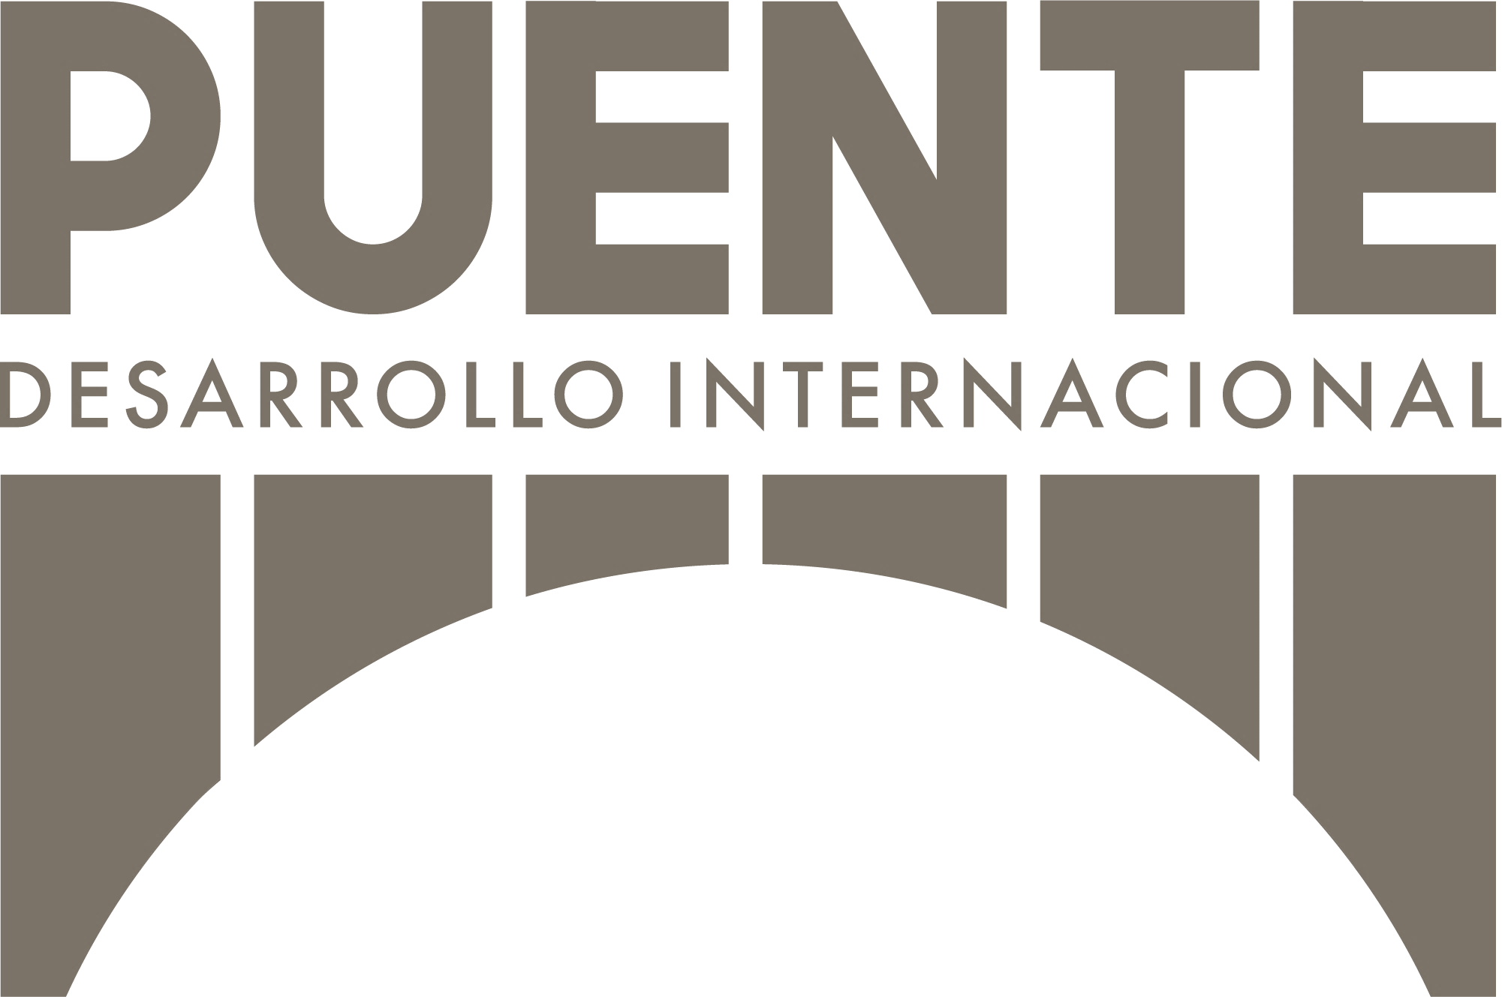

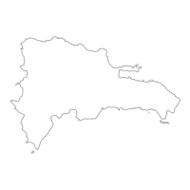
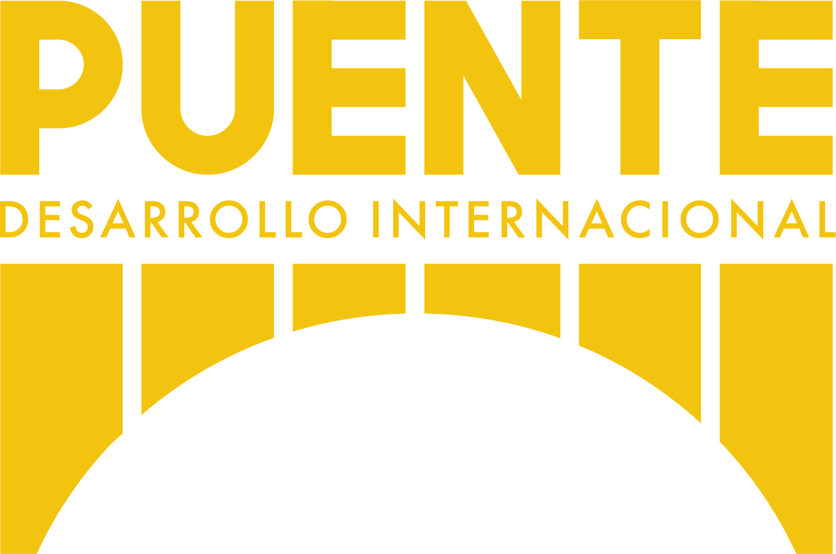




Puente: Being the Bridge
We build puentes between institutions who want to help & communities who need help, supporting enhanced efficiencies across the development process
Development Organizations
Underserved Communities
Local Community Relationships & Trust
Realtime Community Health Data & Mapping Tools`
Training Program to Empower Local Leaders
Development Expertise & On-The-Ground Resources
Pending 501(c)(3) organization founded 2018
Agile, energetic organization currently working in the Dominican city of Constanza
Close-knit team led by former Peace Corps volunteers who have lived and worked in the DR since 2015

Slide 6
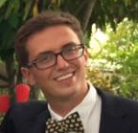
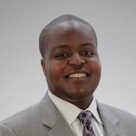





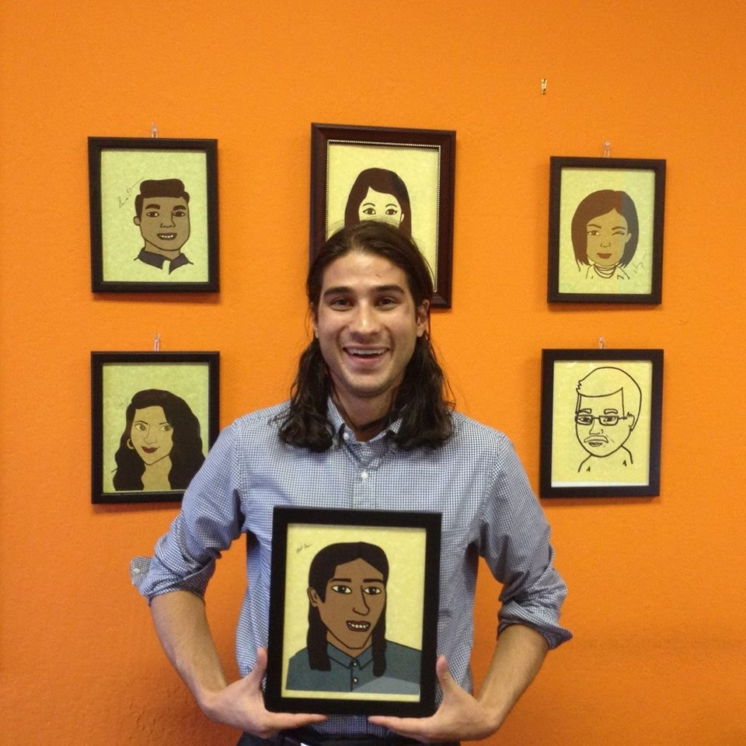
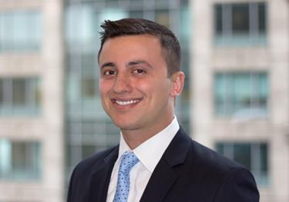


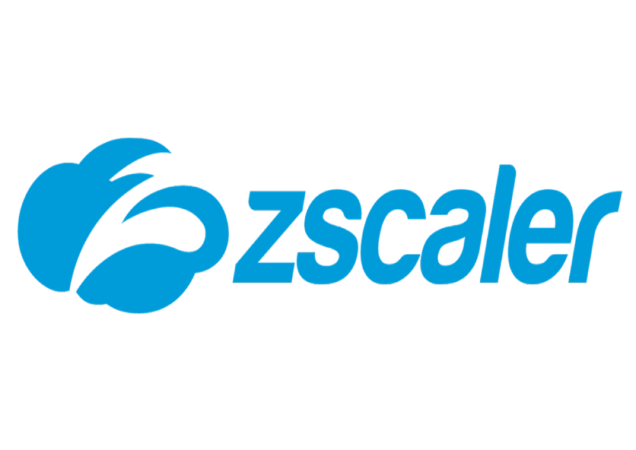




Who We Are
Scott Coppa | Executive Director
Hope Tambala | Director of Technology
Scott has lived and worked in barrios within Constanza since graduating from Notre Dame in 2015, establishing himself as a true friend and leader in the community. As a Peace Corps Community Health Specialist, he successfully implemented dozens of development programs to address needs like sexual education, environmental awareness, and childhood literacy, amongst many others.
Hope is a talented software developer with a passion to use his skills for the benefit of humanity. As a Peace Corps Community Health Specialist, he developed educational programs focused on sexual health, family nutrition, and infectious disease transmission. Previously, he also cofounded a group within M-HEAL that aimed to design a glucometer for low-resource communities.
Education
Experience
Education
Experience
Winner: J. Sinnott Meyers Award for Outstanding Service to the Community
Focus: Global Public Health Informatics
Elliot Grossman | Director
Paul Anthony | Director of Finance
Elliot worked for software companies in Silicon Valley until 2015, when his desire to help others inspired him to join the Peace Corps. As a Peace Corps volunteer, he implemented a range of educational programs for migrant workers on a sugar plantation and founded both a cultural tourism business and a farming collective within the same agricultural community.
Paul is a recovering venture capitalist and investment banker who was compelled to leave his job in finance after a series of service-oriented visits to the DR in 2017. He led a successful fundraising effort to support the construction of an outdoor sports and learning facility at an elementary school in Constanza, and is an associate board member at two Chicago-based nonprofits.
Education
Experience
Education
Experience

Slide 7
2 | Our Strategy & Capabilities

Slide 8
The Puente Platform
Pursuing one core objective through three highly complementary initiatives
Development Consulting & Implementation
Volunteer Training Program
Leveraging experience, resources and connections to support sustainable development work
Design & execute our own projects
Partner with foreign development organizations on their projects
Focus areas: health, education, economic opportunity
Operational today in Constanza, DR
Capabilities grow exponentially through volunteer training program & access to real-time, localized data
Peace Corps-like program for local leaders looking to make a difference in their home communities
Program includes extensive educational course and hands-on training
Puente supports promising project ideas from volunteers and rewards 2+ year volunteers with scholarship and/or employment
Year one goal: complete pilot program with ten volunteers in Constanza
Ensures strong local community ties
Objective:
make development work more collaborative, impactful & sustainable
Data Collection Technology
Proprietary app allows volunteers to collect real-time medical, educational, and economic data traced to specific residences within a local community
Data visualization tools inform needs assessments, project planning
Massive potential benefits for international development ecosystem
System of record for communities in constant need of dev. work
Structured, time series data available to academic researchers, development professionals, medical missions, etc.

Slide 9
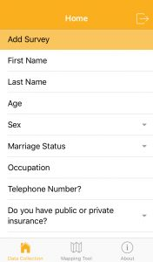
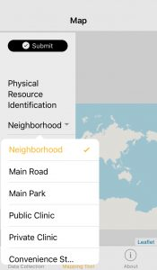
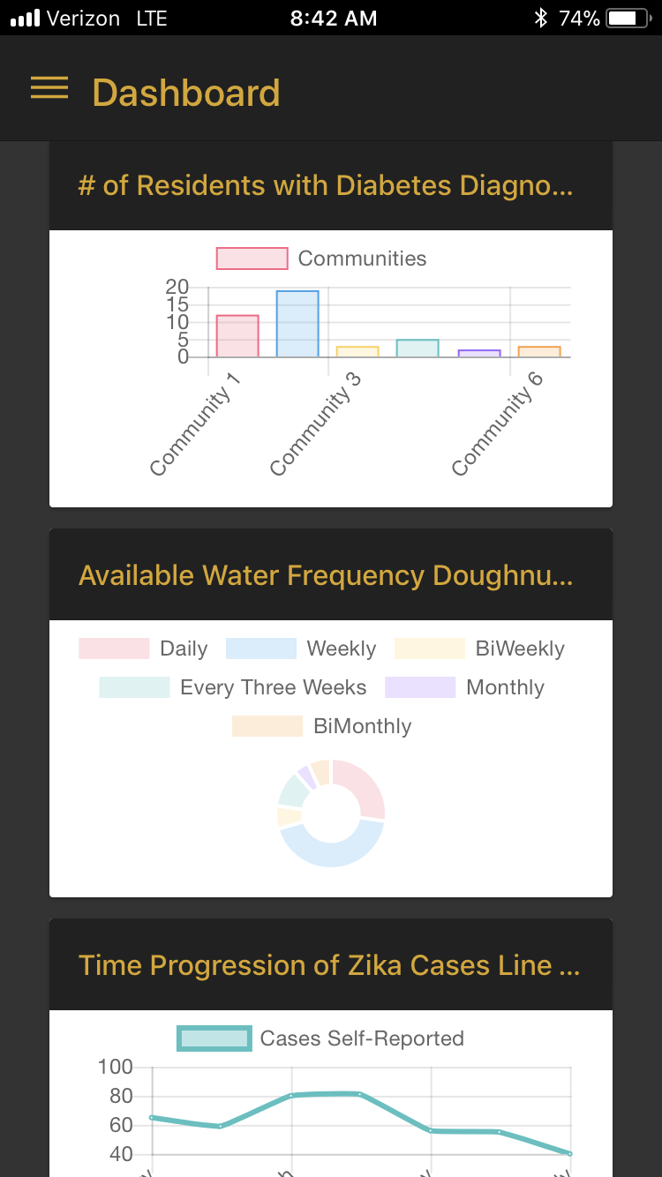
Mobile Data Collection Technology
Puente’s proprietary data collection app is purpose built for development organizations & the communities they serve
Customizable surveys designed to collect the most relevant health and socio-economic data
Geolocation features to map data to community residences in real-time
Community asset mapping services allow development workers to locate the closest healthcare facilities, schools, restaurants, etc. when needed
HIPAA-compliant data collection and storage ensures personal health data is kept secure
Data Collection
Asset Mapping
Analytics Dashboard

Slide 10


How It Works
Our technology helps on-site personnel assess needs and plan projects, while keeping the entire organization connected to its projects and results
On-Site Development Workers & Volunteers
Development Organizations & Other Institutions
Collect health and socio-economic data on community residents via Puente’s app
Use auto-generated maps and data analytics to identify where issues are concentrated
Design projects to address key issues in the most problematic areas, leveraging Puente’s data maps and analytics as supporting evidence
Receive access to data collected by on-site personnel (spreadsheet + analytics dashboard)
Aggregate data across multiple project cycles and regions to drive smarter resource allocation
Monitor project impacts, sustainability, and implementation efficiency to continually improve internal processes and strategies
Puente’s Services & Support
On-the-ground training led by Puente personnel
Ongoing data support to ensure accuracy and proper usage
Project design and implementation consulting
Logistical support to minimize risk and maximize the experience for volunteers / foreign workers
Data sharing and collaboration enabling organizations to get the most fulsome view of the regions they’re serving

Slide 11
Designed for Development
Our technology was built by development professionals, for development professionals – it is the only data solution customized for the development world
`
Process Stages
Needs Assessment
Project Design
Project Implementation
Sustainability Monitoring
Goals & Typical Tasks
Address “gaps” between the current and desired conditions
Listen to community members; facilitate open discussion
Conduct surveys
Identify local resources
Stimulate community ownership/involvement
Recruit and manage volunteers
Create budget, timeline
Outline responsibilities
Use local resources to ensure sustainability
Successfully fill the gap between current and desired condition
Train volunteers and ensure completion of individual tasks
Fundraise (if needed)
Adhere to budget
Evaluate project success using key indicators, follow-up interviews
Solicit feedback
Communicate plans and responsibilities for ongoing maintenance
Data Tactics & Benefits
Preview needs and resources before arrival
Conduct surveys via mobile app to automatically map and catalog data
Time Savings + Superior Insights
Visualize needs and resources to inform project design
Quantify costs and potential impact for fundraising, budgeting
Smarter Design + Simpler Forecasting
Easily find and locate subjects, patients, volunteers, etc.
Monitor progress relative to goals and quantified needs
Efficient Execution + Accountability
Conduct post-project surveys via mobile app
Compare results vs. goals/needs
Understand long-term impact of projects
Actionable Insights for Future Projects

Slide 12
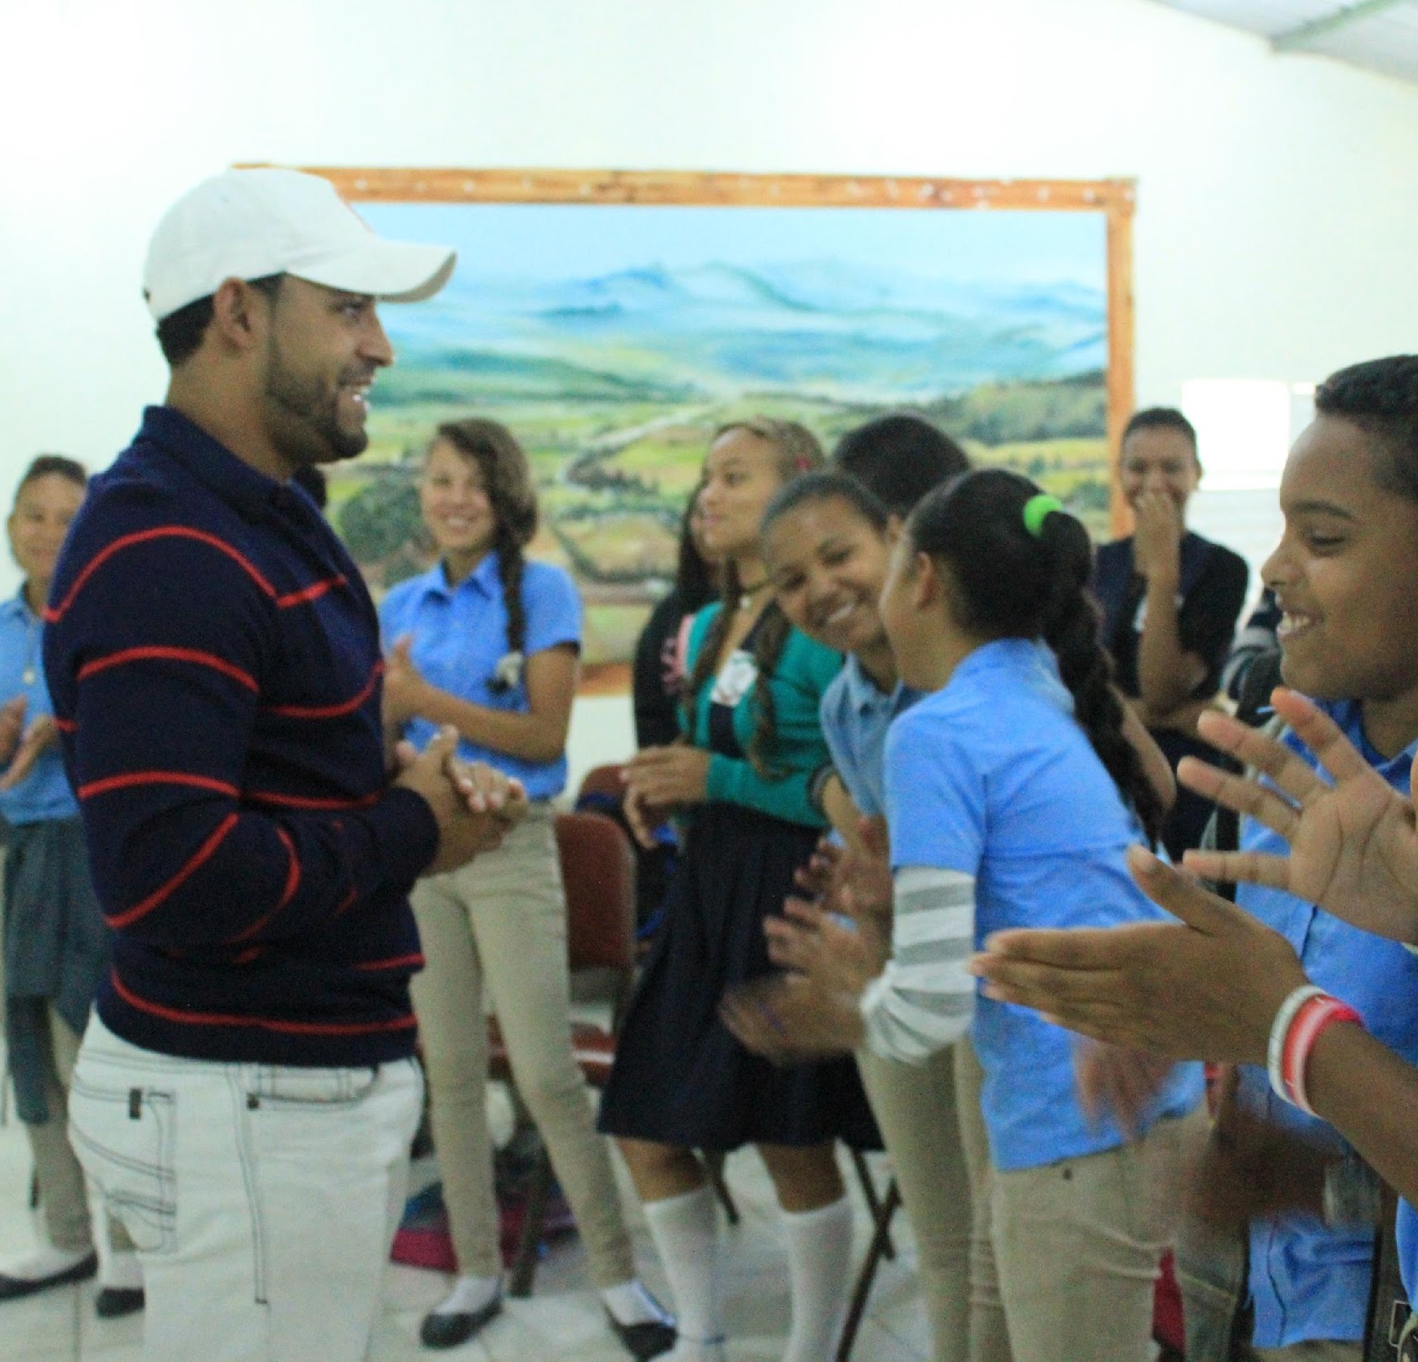
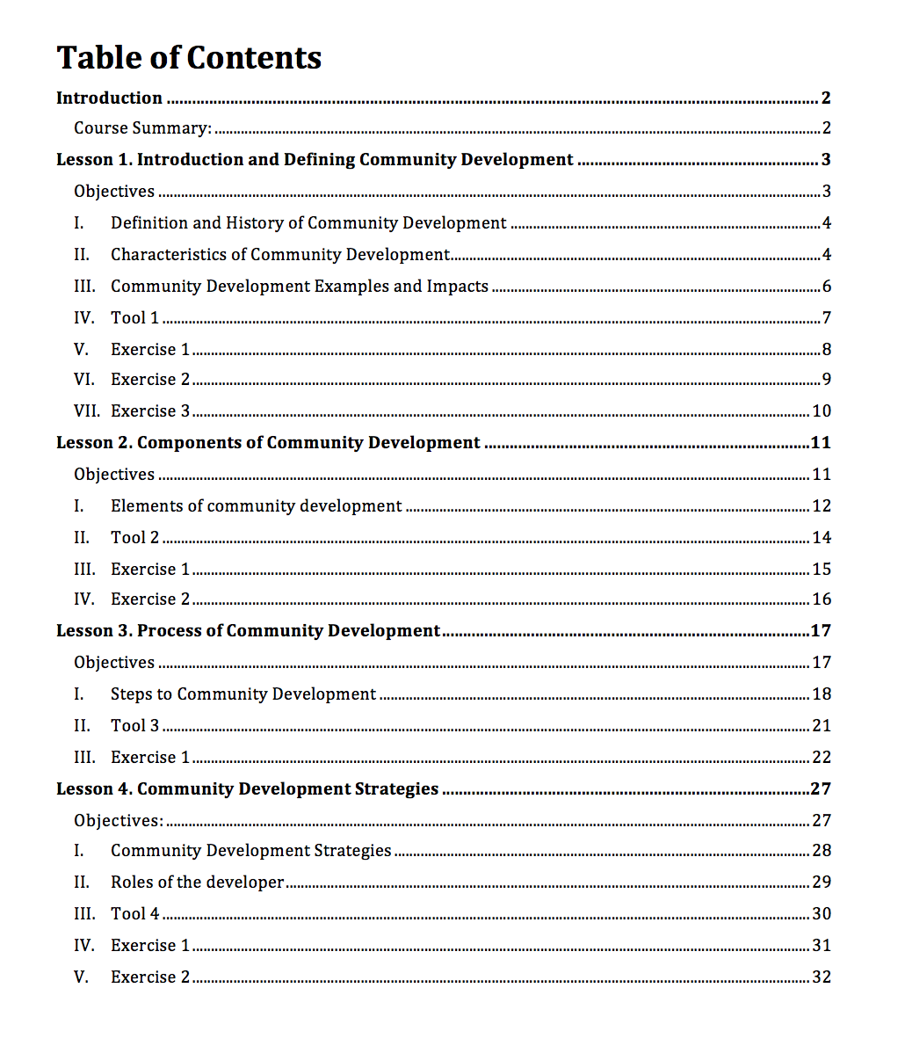
Volunteer Training Program
We empower local residents to help them collaborate with outside organizations and take ownership of development efforts within their home communities
10-week program featuring educational curriculum and hands-on training
Coursework covers three modules designed to teach volunteers the principles of international development
Volunteers are empowered to source, design, and implement projects in their home communities
Participants who meet Puente’s graduation requirements can apply for project funding, collaborate with Puente’s partner organizations
Sample Program Manual

Slide 13
Development Consulting & Implementation
Leveraging our technology and relationships, alongside extensive hands-on experience, to implement sustainable development projects
Development Consulting
Project Implementation
Full-suite of services and technology to ensure the success of projects led by partner organizations
Educated, experienced team members consult on every aspect of a project, from initial design to sustainable upkeep
Puente’s team, with the help of volunteer training program graduates, will continue to source, design and implement our own development projects
Current focus = health infrastructure projects in the DR
Who We Collaborate With
Representative Past Projects
International development organizations
Local government bureaus and officials
Medical missions
Researchers and educational organizations
Neighborhood associations and other community leaders
Sexual health / education workshops
Water canal and aqueduct construction / repair
Implementation of latrines and hygiene facilities
Construction and maintenance of recreation facilities
Childhood literacy initiatives

Slide 14
3 | References & Past Projects

Slide 15
References
Please contact any of the below individuals to hear about their experiences working with Puente’s team on past projects and initiatives
Name / Title | Relationship Context | Contact Information
Angel Tiburcio Executive Director – Constanza English Institute (CEI) | Collaborated closely with Scott on Escojo Mi Vida (sexual education) programming, water canal projects, and outdoor sports and learning facility construction Used a small loan from Puente to found CEI | P: 809-545-4118 E: angelcristian10@gmail.com
Ambiorix Sanchez Caraballo Mayor – Constanza, DR | Worked with Scott on water canal projects, environmental initiatives and other programming Supported Scott’s efforts to create neighborhood association in local community | P: 809-539-2660 E: ambiorix_2003@hotmail.com
Greg Rudolph Assistant Dean – Harvard University | Collaborated with Scott and Hope to design and execute multiple medical and dental missions, offering public health fairs and free plastic surgery / dental work | P: 802-598-3466 E: gregory.marc.rudolph@gmail.com
Fernando Quezada Director – Constanza School District | Key partner in Scott’s implementation of an interactive sexual health education program in 13 schools | P: 849-916-5163
Miguelina Duran School Psychologist, Educativo Arroyo Arriba | Collaborated with Scott on Escojo Mi Vida implementation and ABCDiario (childhood literacy) programming in Dominican elementary schools Assisted Scott and Paul in designing outdoor sports and learning facility | P: 809-803-6836

Slide 16
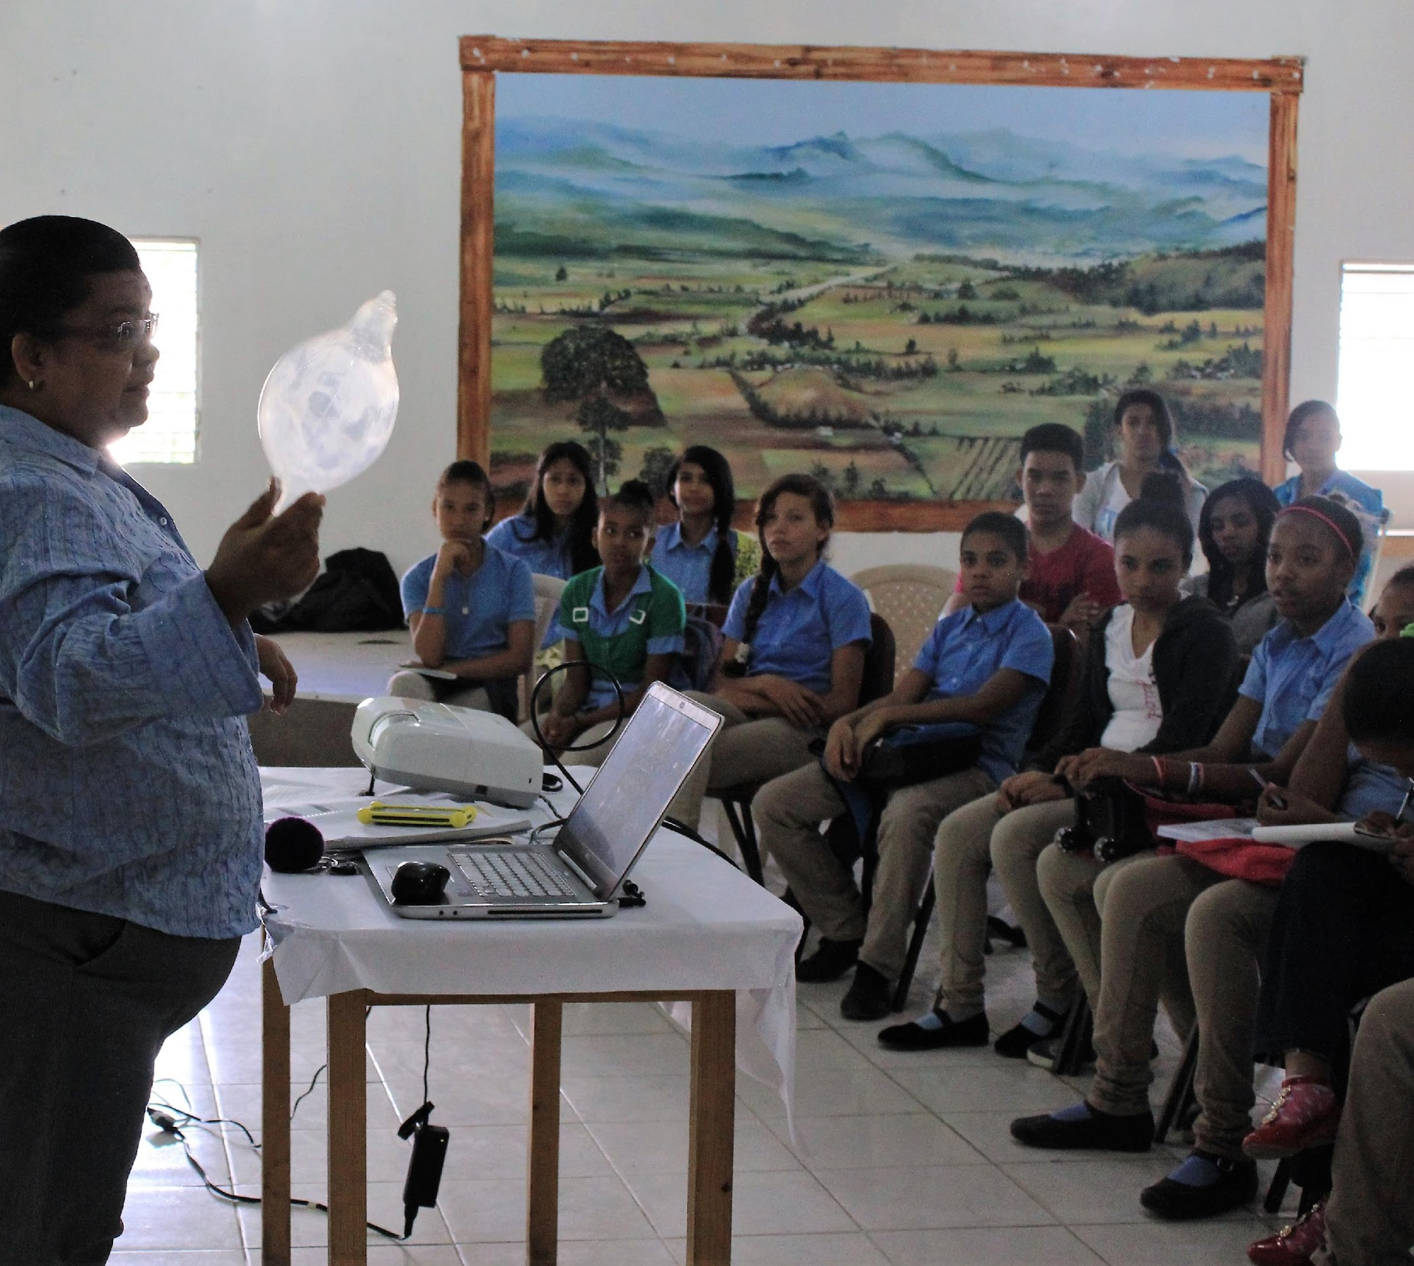
Escojo Mi Vida (I Choose My Life)
Interactive sexual education program graduating 500+ students in Constanza
Background
Scott Coppa designed, coordinated and implemented, sex-ed program to address significant, growing problems in local communities
AIDS (~500 new cases in Constanza annually); Syphilis (~120 pregnant mothers impacted annually); teenage pregnancy (~82 in Constanza <18)
Implementation
Partnered with 5 local schools + city hall to incorporate program into curriculum
Worked with school psychologists to select and educate student promoters, who graduated with the ability to be instructors of program in the future
Designed and coordinated promoter-led courses for rest of student body
Outcomes
20+ courses completed throughout Constanza and surrounding villages
125+ lessons designed and conducted by students themselves
117+ students completed training to become promoters of Escojo Mi Vida program
22 went on to implement program in own school for 400+ classmates
This school saw pregnancies decrease from 20 > 2 in following year

Slide 17
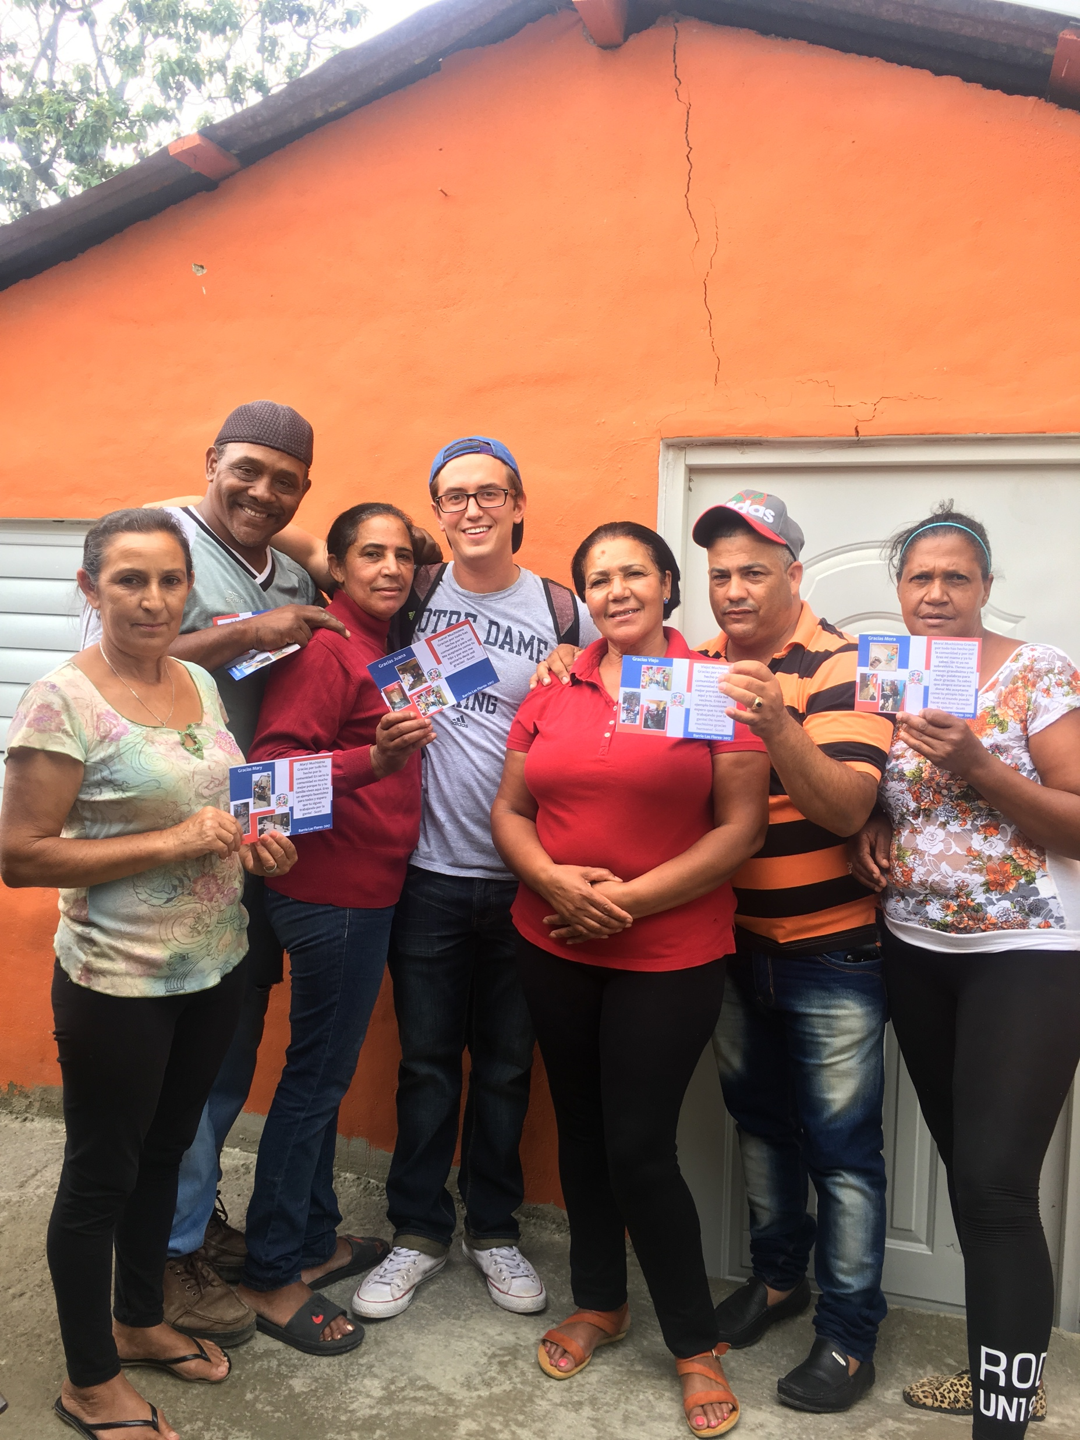
Junta de Vecinos (Neighborhood Association)
Community leaders serving 8,000 residents in Barrio Las Flores
Background
Scott Coppa created a new neighborhood association to catalyze community action projects and address significant, growing problems in the community
Large infrastructure problems; high prevalence of chronic disease, delinquency, teenage pregnancy, and STIs
Implementation
Organized effort to bring 50+ community leaders together to set association rules/guidelines + elect officials
Collaborated with community leaders + city hall to attain official association status
Managed elected officers and oversaw weekly meetings
Outcomes
Catalyzed strong community participation on 2 major infrastructure projects (water canals + basketball court)
10,000 $RD generated in 1 year for housing projects + medical emergencies
8+ small scale community action projects completed in 2 years
Connected with 5 outside organizations in 1 year to carry out projects, programs, medical missions and intercultural exchanges

Slide 18
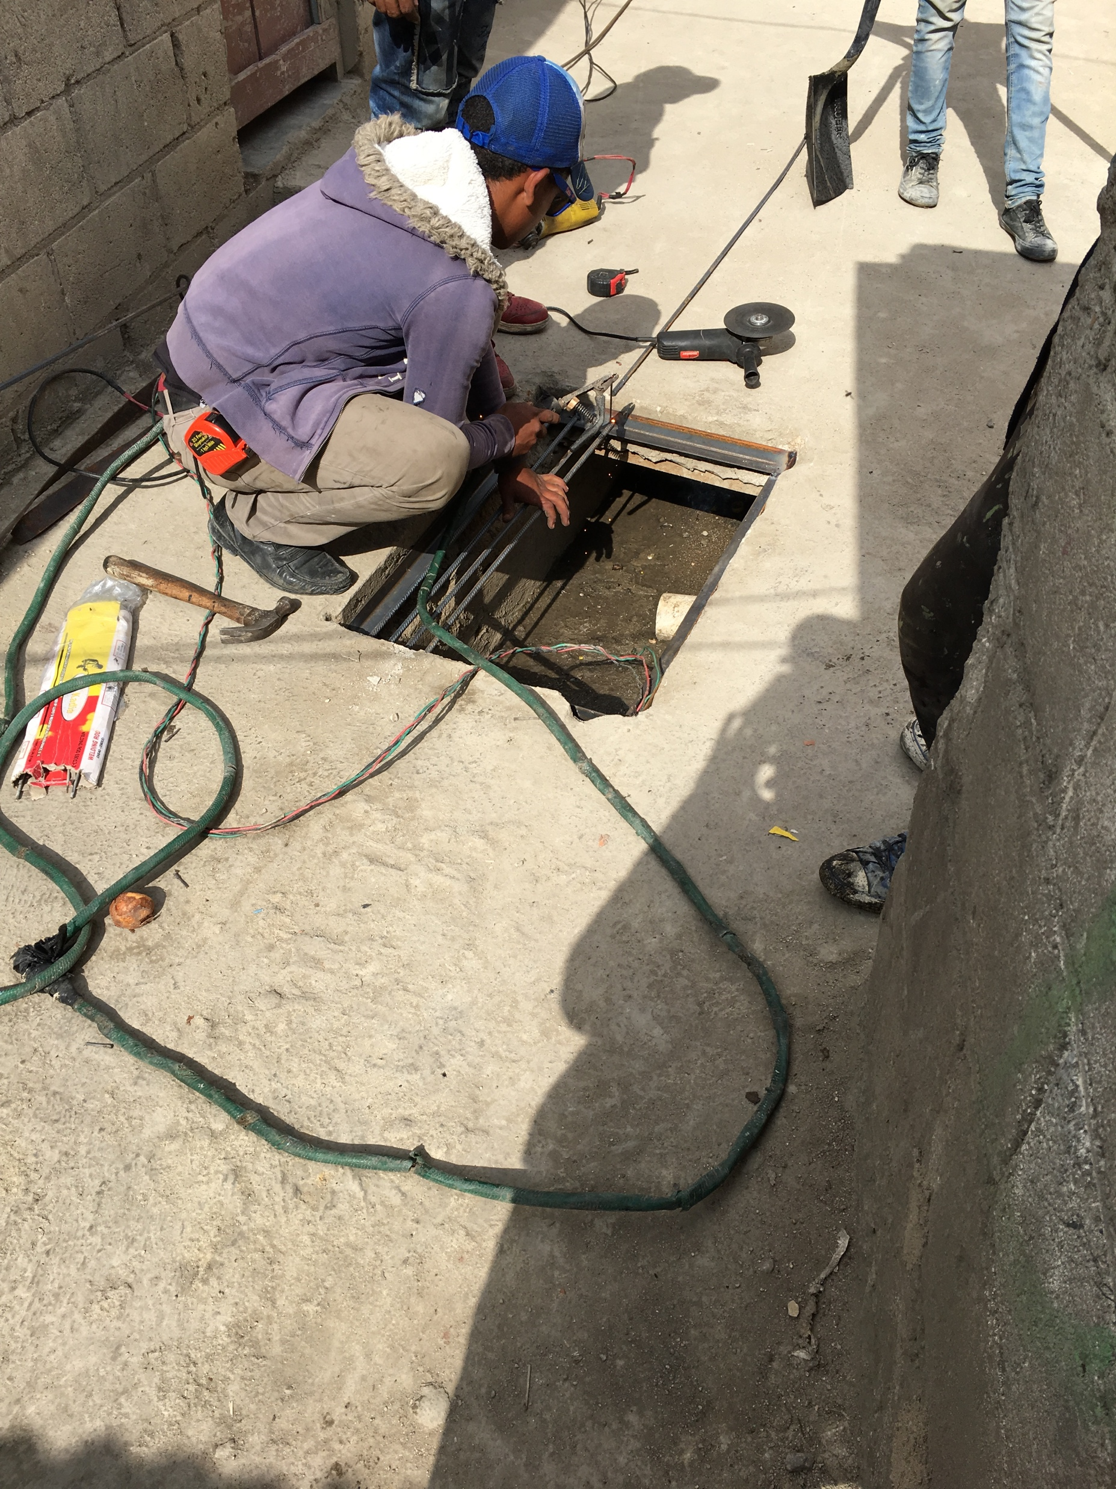
Water Canal Project
Reconstructing 150 meters of wastewater pathways in local community
Background
Scott Coppa designed, solicited, implemented, and managed a water canal improvement project based in local community to combat persisting health + environmental issues
~80% of residents suffering from respiratory issues lived in close proximity to open canal ways, contaminated with blackwater
Implementation
Organized meetings with neighborhood association to analyze data + design project
Solicited and received grant via Peace Corps for $5,850 USD
Managed 15+ community members, who where responsible for constructing the canals + implementing an educational component
Outcomes
140+ meters of canal reconstructed (exceeded original expectation by 100%)
38% of overall project costs were provided by community (labor-in-kind, equipment, etc.)
2,000 beneficiaries served
200+ individuals received training on proper sanitation and waste-management
2 additional canal projects were completed after successful initial phase

Slide 19
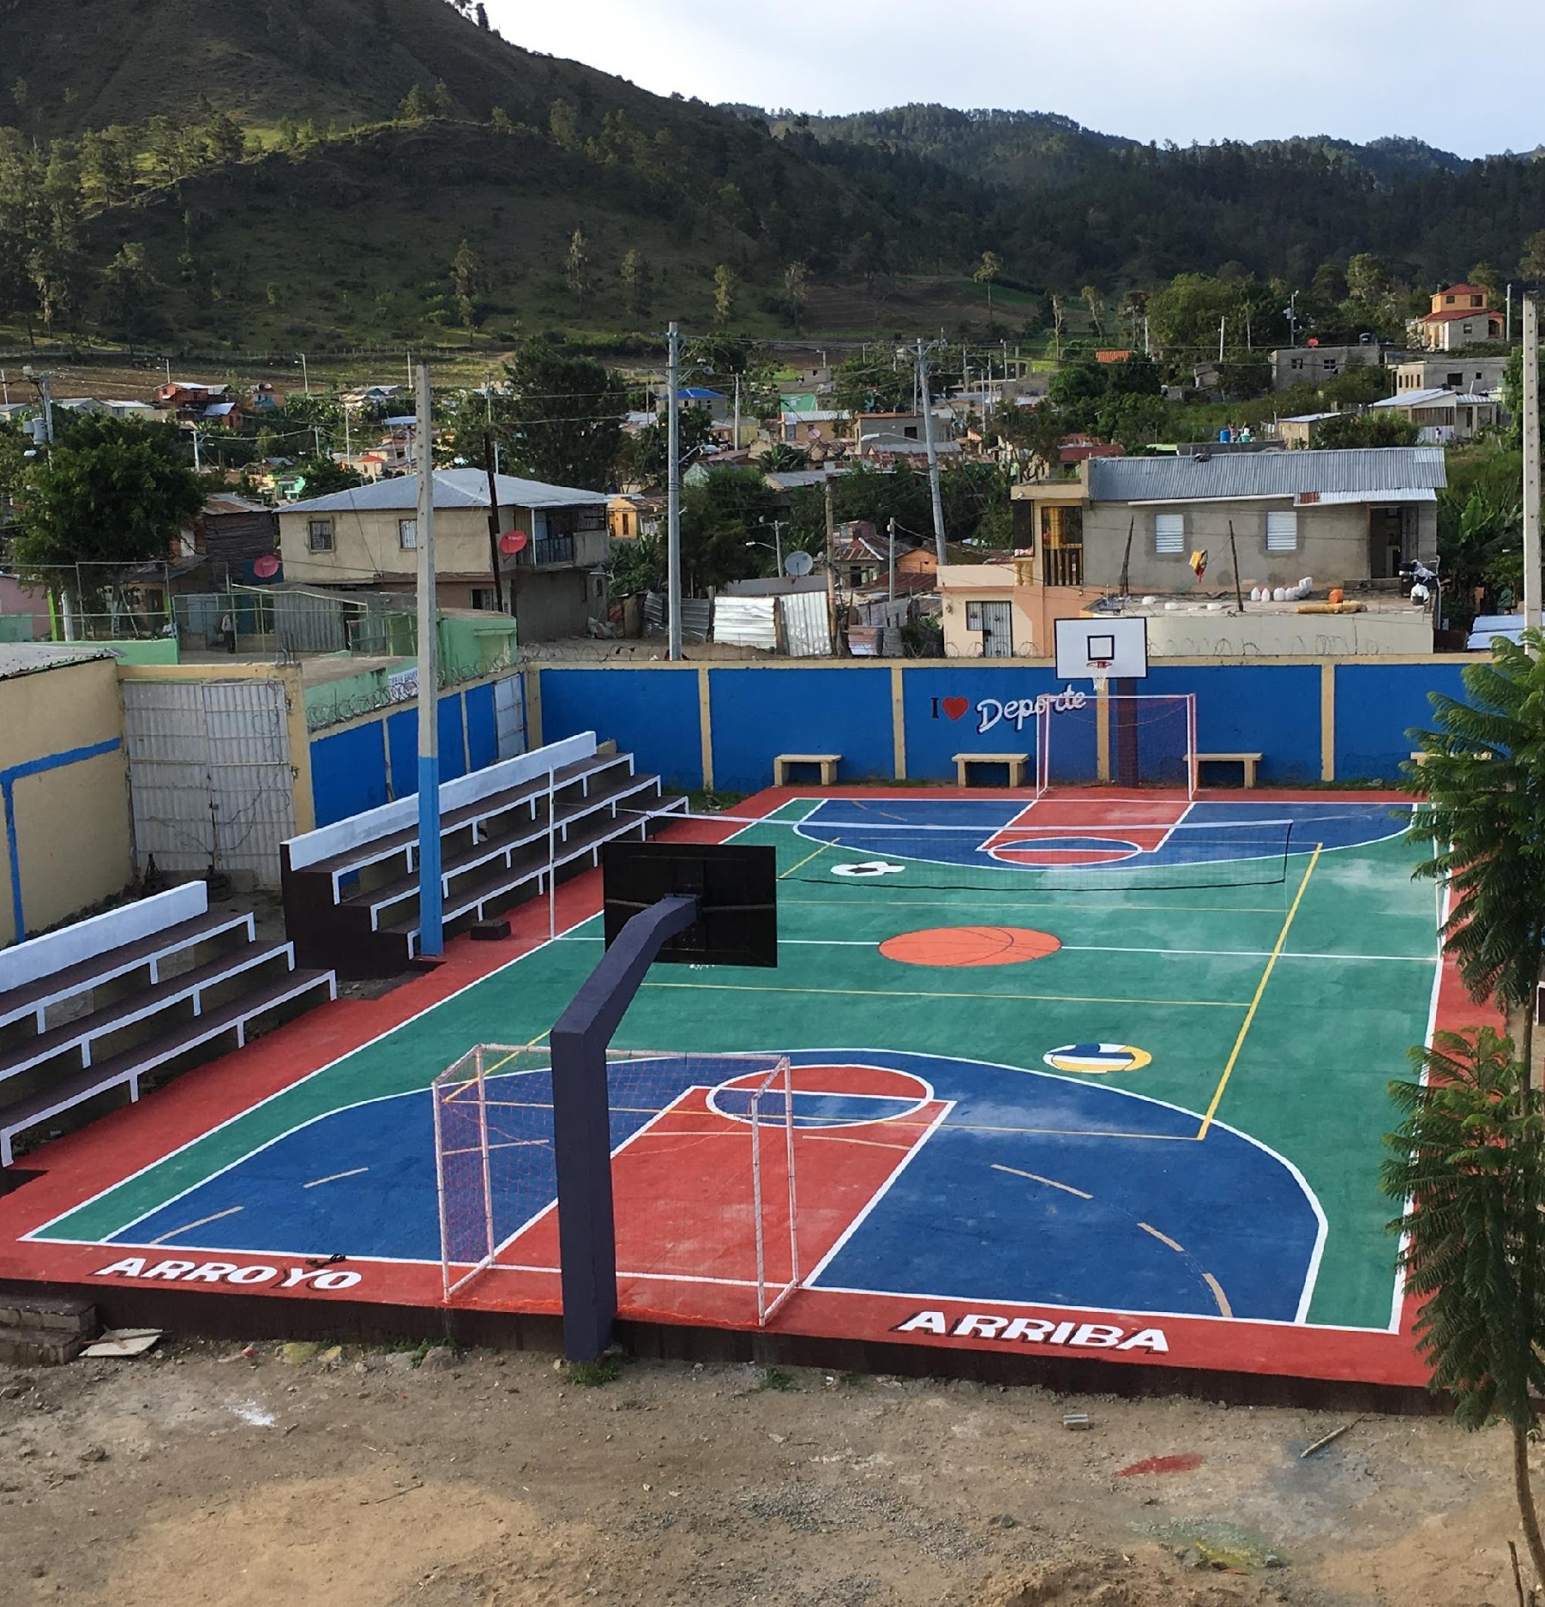
Outdoor Sports & Learning Facility
Safe space for 1,000+ youth in local school/community
Background
Scott Coppa and Paul Anthony collaborated to construct new athletic facilities in a local school to address infrastructure needs + combat delinquency
Delinquency (85% of interviewees thought delinquency was the biggest problem within community)
Local school lacked recreational facilities for ~1,000 students
Implementation
Organized meetings with local leaders + school officials to discuss desired outcomes, indicators, timeline
Recruited local workers and volunteers to assist with the construction
Managed 10+ workers and oversaw daily work
Outcomes
Completed project in 2 months (other orgs. budget ~1 year for similar projects)
Total project cost = $6,500 (Courts for Kids organization budgets $10k per court)
1000+ local youth benefitting from facility’s availability
2+ afterschool sports programs catalyzed
Sustainability: School has taken ownership of facility maintenance, adding new paint for the court + cement for surrounding area in next year’s budget

Slide 20
[Case Study – Slide Template]
[Brief overview of project / key highlights]
Background
[Picture]
[Where, when, why, etc.]
[ ]
[ ]
Implementation
[Description of how project was executed, with stats / highlights]
[ ]
[ ]
Outcomes
[Key highlights, success measures, reviews, etc.]
[ ]
[ ]

Slide 21
The Untapped Benefits of Development Data
Implementing modern data collection technology can drive massive near- and long-term benefits for development organizations & underserved communities
Intangible
TBU; not sure if this is best layout
Immediate
Long-Term
Tangible

